Slide 1
Mixed Effects Modeling-II
Fish 559; Lecture 4
Notes:
a

Slide 2
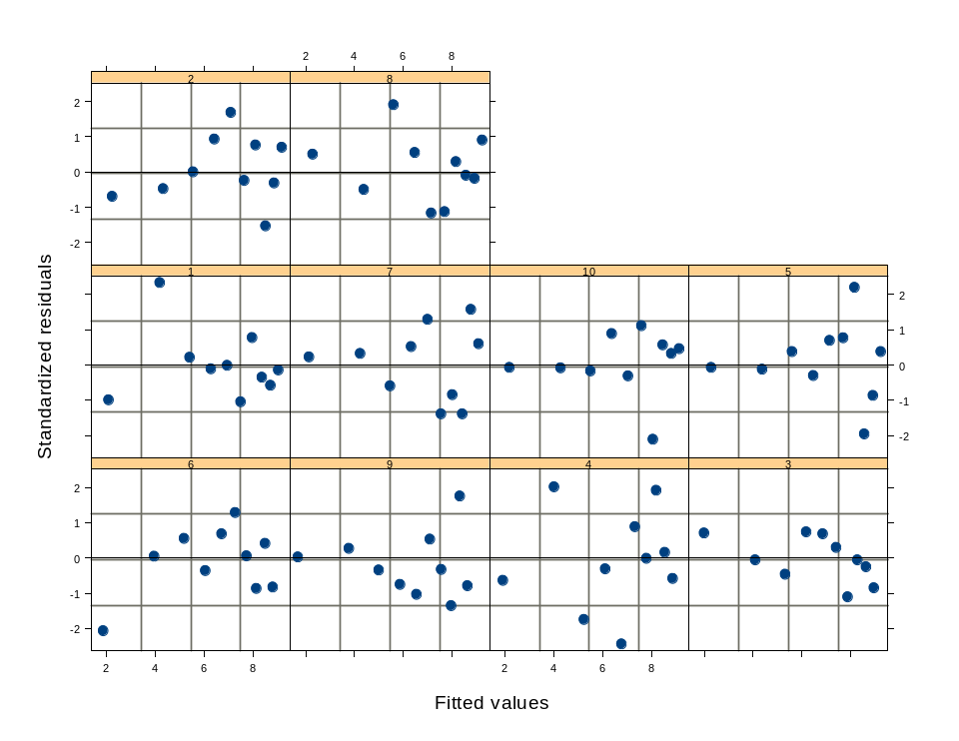
Tricks and Traps-II
Residuals and the like:
  To plot Pearson residuals:
  plot(lmout,form=resid(.,type="p")~fitted(.)|Subject,abline=0,pch=16)
You can also have
interactions (random
effects within random
effects)
You can also have
different variances for
different groups.

Slide 3
Tricks and Traps-III
It is possible to allow for differences in within-group variability, i.e.:
It is also possible to allow for correlation among the within-group residuals.
Use the varFunc and corStruct classes. This also allow weighting of different data points.
Variance function
Variance covariate

Slide 4





Further R Tricks
(Variance formulae)
The varFunc class:
  varFixed:
  varIdent:
  varPower:
  varExp:
  varConstPower:
  varComb: Combinations of variance functions
Notes:
  varPower(initial value, form, fixed)
  vf1 <- varPower(0.2, form = ~age|Sex)
  vf1 <- varPower(0.2, form = ~ fitted()|Sex, fixed=list(Male=0.5, Female=0))

Slide 5
Packages
The function lmer (in package lme4) also implements linear mixed models (including generalized linear models).
lmer doesn’t have all the functionality of lme – however, both packages should be considered in any application.

Slide 6
Back to an Example
The file Lect4a.txt contains data on the profit of 20 boats. Use
these data to explore the support for the following models
(assume a boat-specific intercept):
Latitude as a main effect; boat-specific variances
Latitude*Longitude as main effects; boat-specific variances
Latitude*Longitude as main effects; constant variance

Slide 7
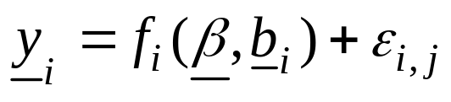
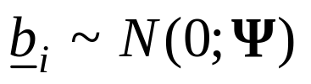
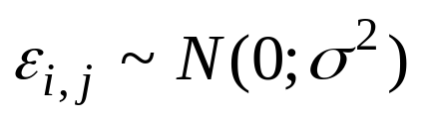
Extensions to the Linear Mixed Model
A non-linear relationship between the response variable and the co-variates:
A non-normal distribution for the random effects.
A non-normal distribution for the within-group variability.
We only discuss extension 1) here. Extensions 2) and 3) will be discussed when we talk about STAN.

Slide 8
Non-linear Mixed Effects Models
(Some Examples)
Modeling age and length data for animals that are measured multiple times.
A meta-analysis for the parameters of the stock-recruitment relationship for many stocks.
A surplus production model with process and observation error**.
An age-structured population dynamics model with recruitment variability (Stock Synthesis)**.
** These can be dealt with more straightforwardly by adopting a Bayesian rather a classical estimation framework.

Slide 9
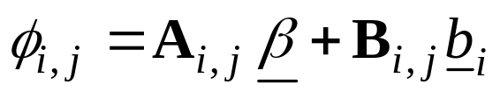
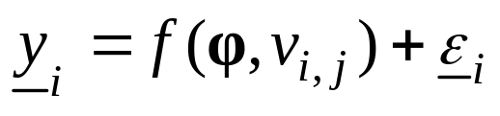
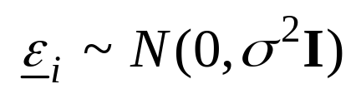
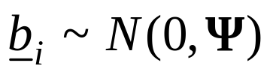

Theoretical Aspects-I
Function relating the
parameters and covariates
to the observations
Fixed effects
Random effects
Observations for group i
This matrix will be a
function of parameters, Θ

Slide 10
Time Out-I
(First Example – length and age)
We shall assume that:
  Growth follows a von Bertalanffy growth equation.
  t₀ and κ are the same for all animals in the population while the asymptotic size differs among individuals.
  There is normally distributed measurement error.

Slide 11
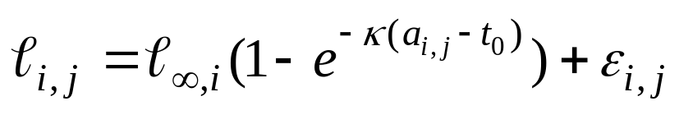
Time Out-II
(First Example – length and age)
Now for the general case:
For the specific case of a von Bertalanffy growth equation:
The response variable
The fixed effects
The random effect
The covariate

Slide 12
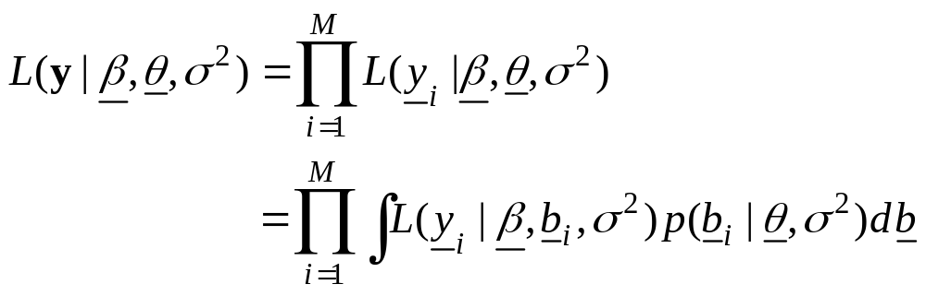
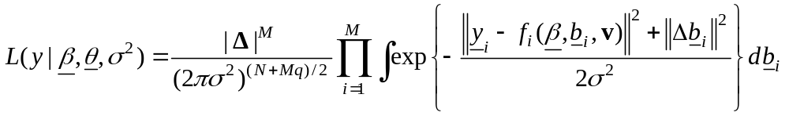
Theoretical Aspects
As before:
This simplifies to:
The integrals cannot be evaluated analytically and so numerical
approximation methods are needed to find the Maximum
Likelihood (or REML) estimates for the model parameters.

Slide 13
Non-linear Mixed Effects models
(Fitting techniques)
R can be used to fit non-linear mixed effects models (function NLME). However, SAS appears to be more powerful (e.g. can handle non-normal error distributions).
To fit non-linear mixed effects models using TMB / EXCEL you need to evaluate the integrally numerically / apply a method such as the Laplace transformation.

Slide 14
Fitting Length and Age Data
(Background)
We have 10 subjects (animals).
Each animal is measured 10 times between age 1 and age 10.
Growth follows a von Bertalanffy growth equation where the asymptotic size is subject-specific and the growth rate and age at zero size are the same across subjects.

Slide 15
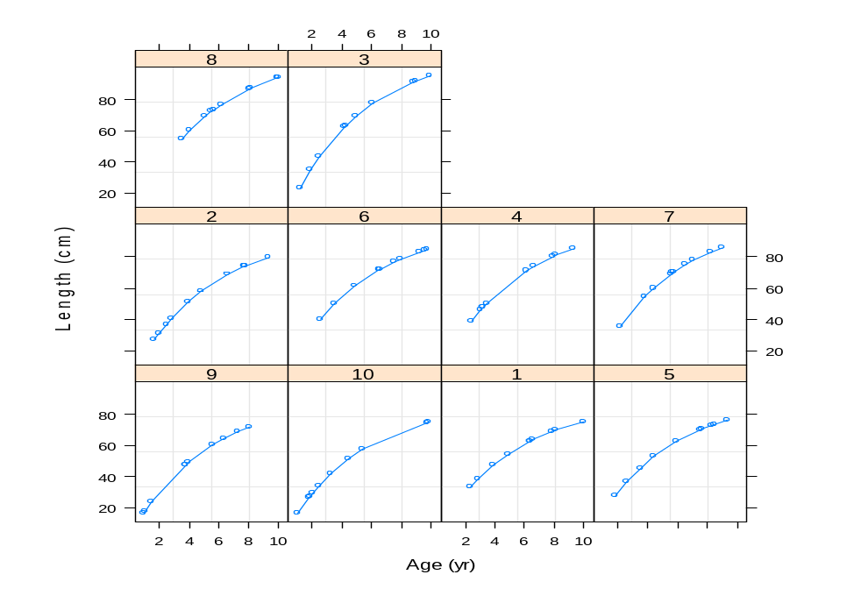
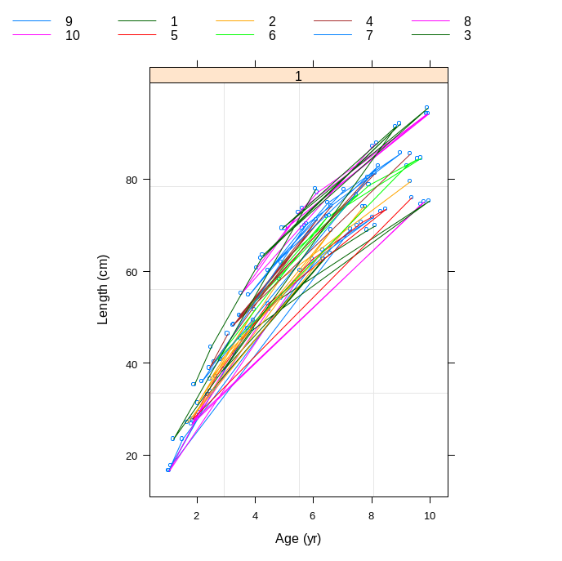
Fitting Length and Age Data
(The basic data)
FileName <- “LECT4B.TXT"
TheData <- scan(FileName, what=list(Subject=0,Age=0,Length=0,NULL), skip=1, n=4*100)
xx <- as.data.frame(cbind(Subject=TheData$Subject,Age=TheData$Age,Length=TheData$Length))
AgeLen <- groupedData(Length~Age|Subject, data=as.data.frame(TheData), labels=list(x="Age",y="Length"), units=list(x="(yr)",y="(cm)"))
plot(AgeLen)
plot(AgeLen,outer=~1)

Slide 16
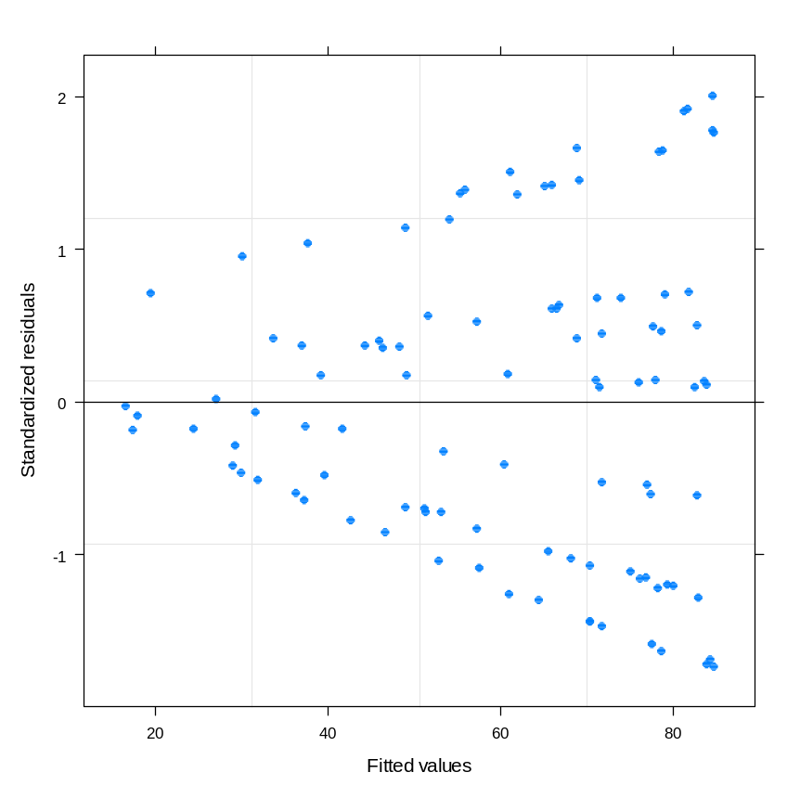
Fitting Length and Age Data
(Standard non-linear model-I)
lm1 <- nls(formula=Length~Linf*(1-exp(-1*Kappa*(Age-Tzero))),
data=AgeLen, start=c(Linf=100,Kappa=0.2,Tzero=0))
There is evidence in the
residuals for model-
mispecification. This is
not heteroscedastic errors
rather it is correlation
among observations for the
same animal.

Slide 17
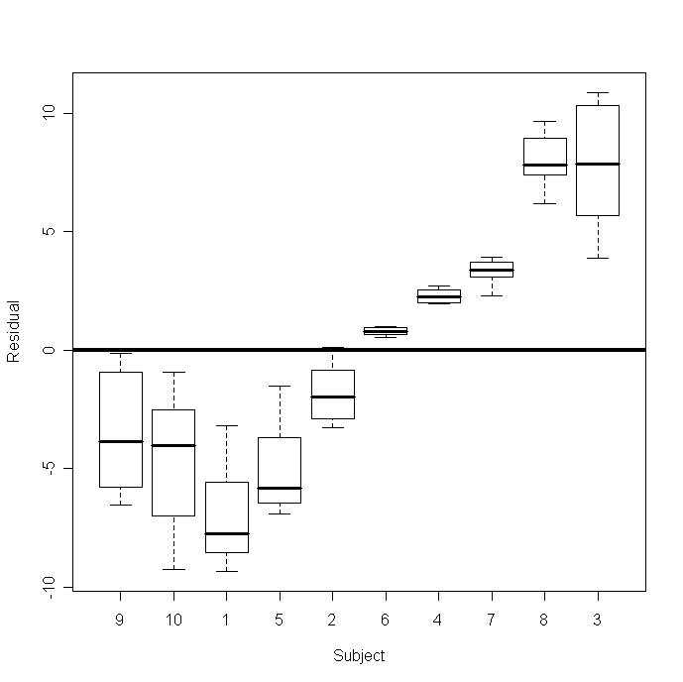
Fitting Length and Age Data
(Standard non-linear model-II)
boxplot(split(residuals(lm1),AgeLen$Subject),ylab="Residual",
xlab="Subject",csi=0.2)

Slide 18
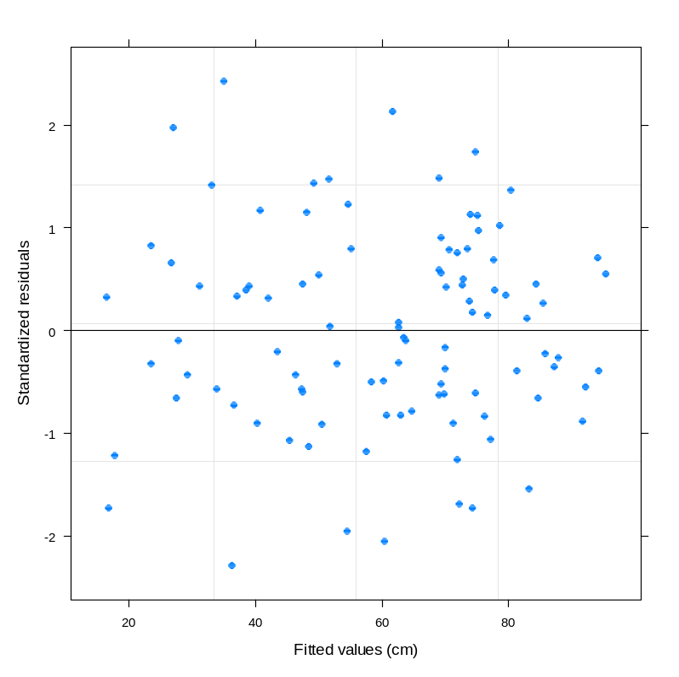
Fitting Length and Age Data
(Non-linear mixed model-I)
lm2 <- nlme(model=Length~Linf*(1-exp(-1*Kappa*(Age-Tzero))), data=AgeLen,
random=Linf~1, fixed=Linf+Kappa+Tzero~1,start=c(Linf=100,Kappa=0.2,Tzero=0))
Print(lm1$modelStruct)
Random effect:
Linf by subject
Fixed effects:
Linf population mean
Kappa
t₀

Slide 19
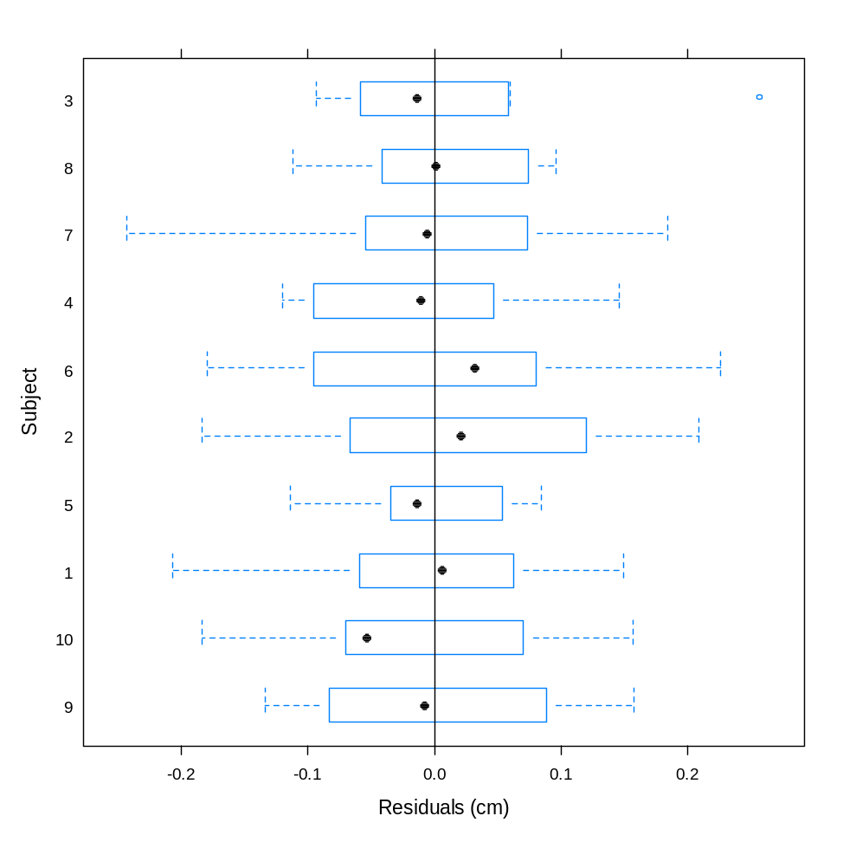
Fitting Length and Age Data
(Non-linear mixed model-II)
plot(lm2,Subject ~ resid(.),abline=0)
Try “intervals (lm2)” to see
the confidence intervals

Slide 20
Fitting Length and Age Data
(Non-linear mixed model-III)
Nonlinear mixed-effects model fit by maximum likelihood
Model: Length ~ Linf * (1 - exp(-1 * Kappa * (Age - Tzero)))
Data: AgeLen
AIC BIC logLik
-53.64647 -40.62062 31.82323
Random effects:
Formula: Linf ~ 1 | Subject
Linf Residual
StdDev: 8.28837 0.1060163
Fixed effects: Linf + Kappa + Tzero ~ 1
Value Std.Error DF t-value p-value
Linf 97.02240 2.6629267 88 36.4345 0.0000
Kappa 0.19960 0.0005324 88 374.8752 0.0000
Tzero -0.00453 0.0040570 88 -1.1176 0.2668
Correlation:
Linf Kappa
Kappa -0.034
Tzero -0.027 0.876

Slide 21
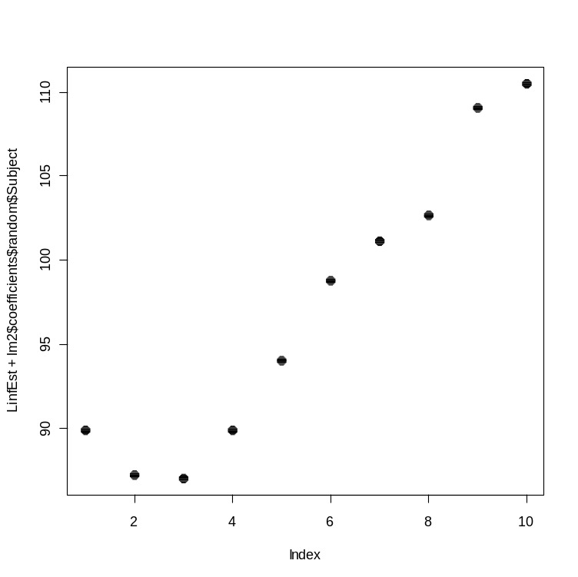
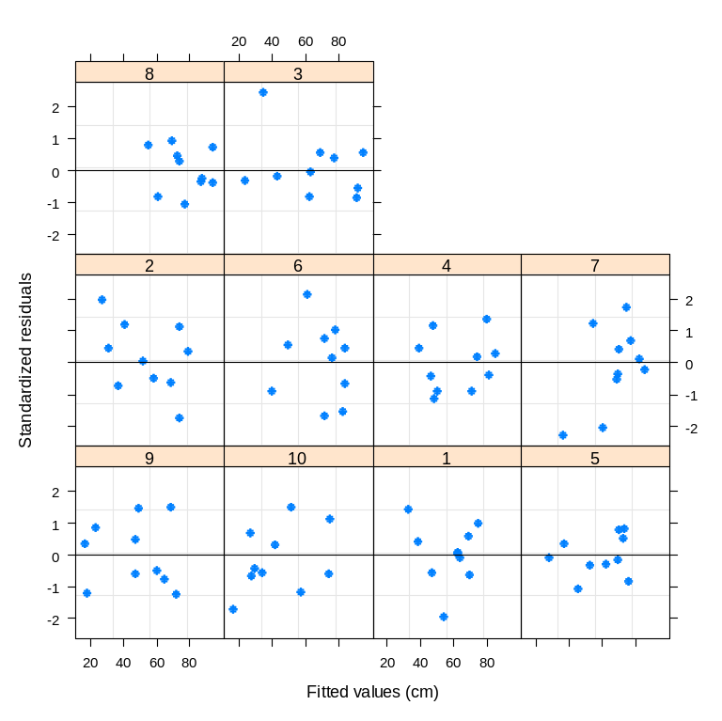
Fitting Length and Age Data
(Non-linear mixed model-IV)
plot(lm2, form = resid(., type = "p")
~ fitted(.) | Subject,
abline = 0,pch=16)
plot(LinfEst+lm2$coefficients$random$Subject,
pch=16,csi=0.3)

Slide 22
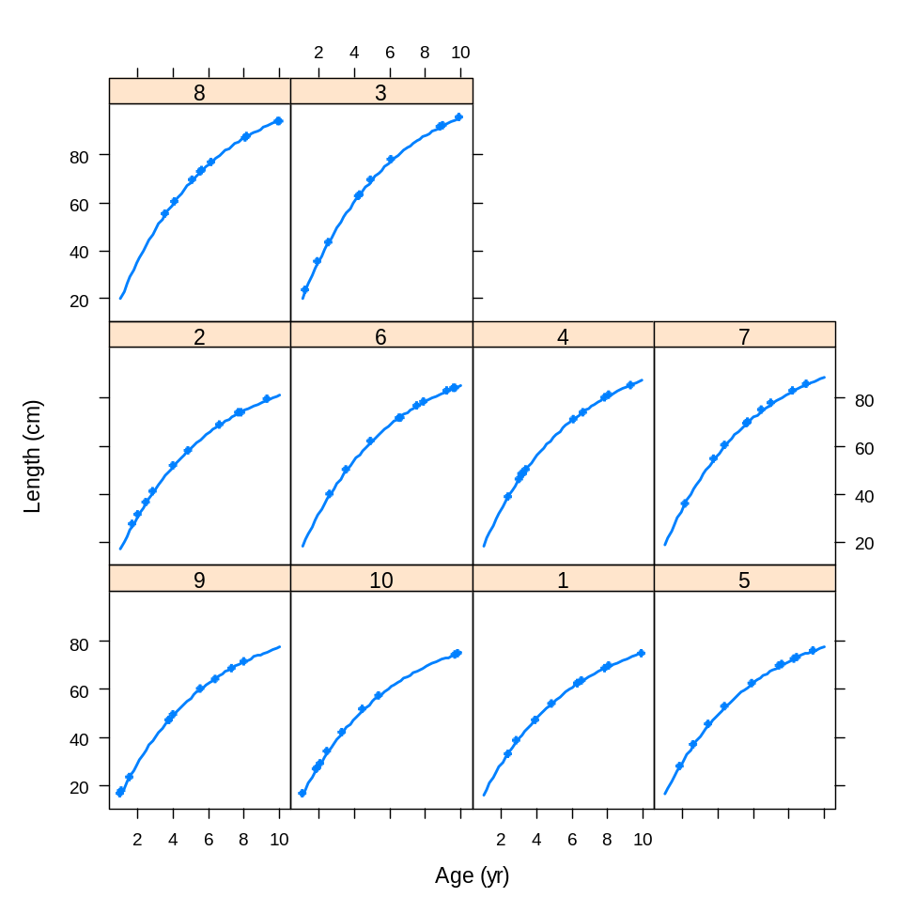
Fitting Length and Age Data
(Non-linear mixed model-V)
plot(augPred(lm2),csi=0.3,pch=16,lwd=2)
Plots the data and
the model
predictions

Slide 23
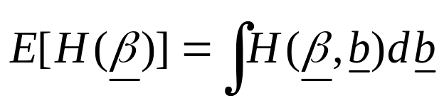
Non-linear Mixed Models
(Population Average estimates-I)
If you fit a mixed effects model and need to know the value of some (non-linear) function averaged across the population, you have to integrate over the random effects, i.e.:
For a linear mixed effects model, this integration is not needed – why?

Slide 24
Non-linear Mixed Models
(Population Average estimates-II)
Consider the case in which selectivity-at-age has been computed from data collected from n sites and the parameters estimated by fitting a mixed effects model, i.e.:
The quantity of interest is the selectivity for age 5.5.
How does this age change with the value of σ.

Slide 25
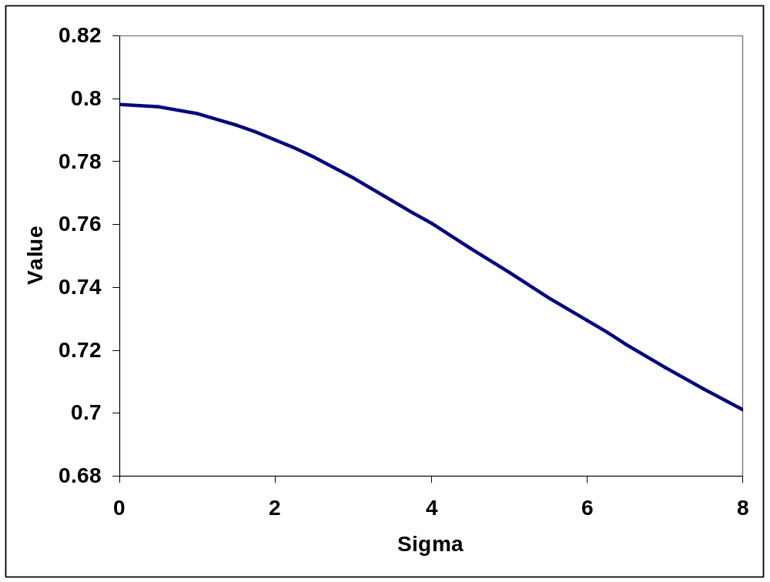
Non-linear Mixed Models
(Population Average estimates-III)
The selectivity of age
5.5 decreases with
increasing σ

Slide 26
The NLME Function-I
The NLME function has several options:
nlme(model, data, fixed, random, groups, start, correlation, weights, subset, method,na.action,naPattern, control,verbose)
model: “response ~fn(fixed effects)”
  you can also supply a function (possibly with its derivatives) – this will be discussed when we deal with non-linear regression methods.
fixed: “fixed = c(fix1~var1,fix2~var2)”.
  There are several ways to specify the fixed effects structure.

Slide 27
The NLME Function-II
nlme(model, data, fixed, random, groups,
start, correlation, weights, subset, method, control)
random: “random=c(rnd1 ~ var1, rnd1 ~ 1)”. Leaving out a “random” specification implies all fixed effects have an associated random effect.
start: “start = c(fix1=x1,fix2=x2,..)” – the initial values for the fixed parameters of the model.
Be wary of using NLME to make predictions when some of the parameters are non-linear.

Slide 28
The NLME Function-III
You can use many of the functions defined for linear models
with nlme, e.g.:
update
logLik
plot
predict
intervals
anova
residuals

Slide 29
References
Bolker et al. (2008). Generalized linear mixed models: a practical guide for ecology and evolution. TREE: 24: 127-35.
Pinheiro, J.C. & Bates, D.M. (2000). Mixed-Effects Models in S and S-PLUS. New York: Springer-Verlag.
Zuur et al. (2009). Mixed-effects Models and Extensions in Ecology with R. New York: Springer-Verlag.

